Slide 1
Digital portfolio
STUDENT NAME :PRAVEEN KUMAR R
REGISTER NO AND NMID :222403560/15F124BDC5E75E5BE43452296F7D65A0
DEPARTMENT : BSC COMPUTER SCIENCE
COLLEGE /UNIVERSITY :SRIDEVI ARTS AND SCIENCE COLLEGE PONNERI /MADRAS UNIVERSITY

Slide 2
PROJECT TITILE
CAR BOOKING

Slide 3
1. Problem Statement 2. Project Overview 3. End Users 4. Tools and Technologies 5. Portfolio design and Layout 6. Features and Functionality 7. Results and Screenshots 8. Conclusion 9. Github Link
AGENDA

Slide 4
PROBLEM STATEMENT
Design a *Car Booking Slot Form* for users to book a car by entering their details such as *name, contact number, car type, booking date, time, and duration*. The form should validate input, display a confirmation message on successful submission, and reset afterward.

Slide 5
PROJECT OVERVIEW
This project is a *Car Booking Slot Form* that allows users to book a car by providing their *name, contact number, car type, booking date, time, and duration*. It includes form validation, displays a confirmation message upon submission, and resets the form afterward. The layout is clean and responsive, styled with CSS, and includes basic JavaScript for interactivity.

Slide 6
WHO ARE THE END USERS?
The end users are *individuals looking to book a car* for personal or professional use by selecting a car type, date, time, and duration through a simple online form.

Slide 7
TOOLS AND TECHNIQUES
* *HTML* – For building the structure of the booking form* *CSS* – For styling the form with a clean and responsive design* *JavaScript* – For client-side form validation and user interaction* *Form Validation* – Ensures all required fields are filled correctly* *DOM Manipulation* – Handles form submission and displays confirmation messages*

Slide 8
POPRTFOLIO DESIGN AND LAYOUT
*Clean & Centered Layout* – Form is centered on the screen for a focused user experience* *Modern UI* – Rounded corners, subtle shadows, and consistent spacing for a professional look* *Responsive Design* – Adapts well to different screen sizes using flexible widths* *Consistent Styling* – Uses a single font, color scheme, and input style for visual harmony* *User-Friendly Form* – Clearly labeled fields, dropdown for car type, and input validation for better usability*

Slide 9
FEATURES AND FUNCTIONALITY
*User Input Fields* – Collects name, contact number, car type, booking date, time, and duration* *Form Validation* – Ensures all fields are filled and contact number is 10 digits* *Dropdown Selection* – Lets users choose a car type from predefined options* *Date & Time Picker* – Easy selection of booking date and time* *Confirmation Alert* – Displays a summary of the booking upon submission* *Auto Reset* – Clears the form after successful booking* *Responsive & Clean Design* – User-friendly interface for all devices

Slide 10
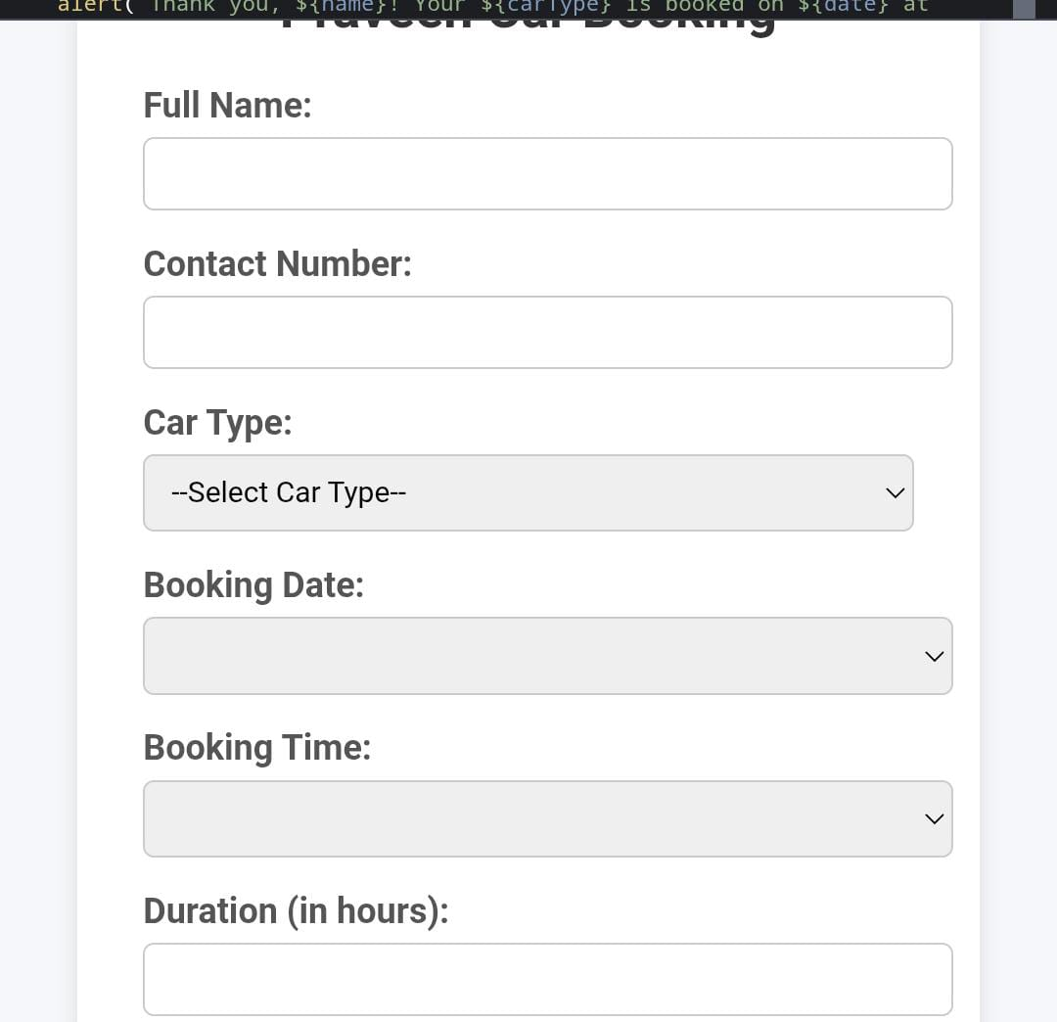
RESULTS AND SCREENSHOTS
* Enter their details* Select a car type* Choose date, time, and duration* Submit the booking with a confirmation alert* See a clean, modern UI that's easy to use

Slide 11
conclusion
This *Praveen Car Booking* web app allows users to easily book a car by selecting the type, date, time, and duration. It dynamically calculates the estimated cost and confirms the booking with a custom pop-up message—offering a smooth, user-friendly experience using *HTML, **Tailwind CSS, and **JavaScript*.

Slide 12
GITHUB LINK
https://github.com/praveen2007847/TNSDC-PWD-PD1.git

